Slide 1
Task 12: Detailed Design
Team: Functor
Project: PowaFinance

Slide 2
Product Description Team: Daniil Slobodeniuk, Dmitriy Egorov, Roman Dubinskiy
Nice and crisp app for tracking finances and investing
Android App which purpose to ease up tracking of expenses. Though there are plethora of similar apps there are certain features that differentiate it:
ML model to project expenses for the next quarter
News API to fetch most applicable financial news
Investing API to give user option to invest in the desired stocks/bonds
Sleek design compared to competitors
Project repo: https://github.com/SleeplessChallenger/PowaFinance
Task precisely: https://github.com/SleeplessChallenger/PowaFinance/tree/master/project_resources/asd/second-module/task%2012:%20Detailed%20Design
This report: https://docs.google.com/presentation/d/1w2AsUYZzNm-z7UWATWuljKJQPdez2n1vEg_BGef3z_w/edit?usp=sharing

Slide 3
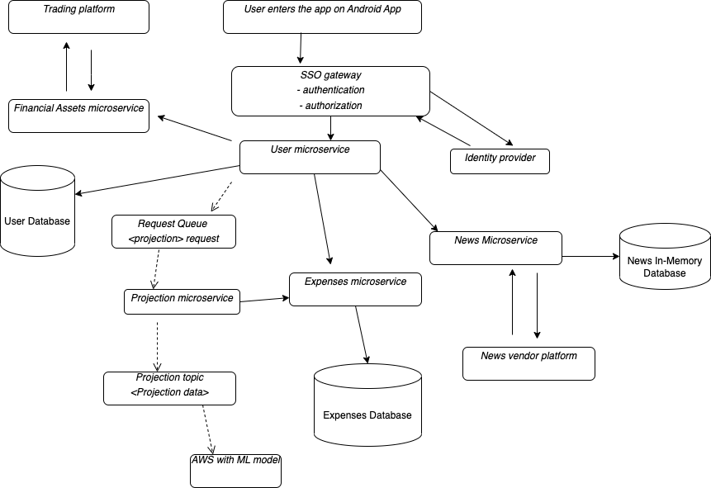
System architecture: DFD diagram
Crucial principles with
description on the next slides
Strategy Pattern
Database per service
IoC with DI
MVC
BFF
Single responsibility principle

Slide 4
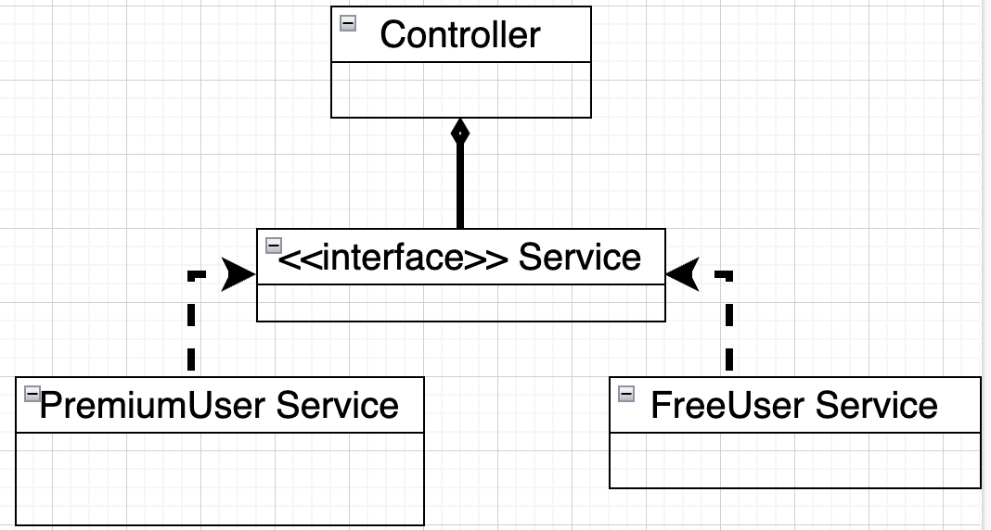
Strategy Pattern
Problem: remove any sign of inheritance and enable flexible substitution of services
Solution: interface for @Service where implementations of it will be added to @Controller class
Result: fast substitution for any new @Service
@Service - is Spring @Bean

Slide 5
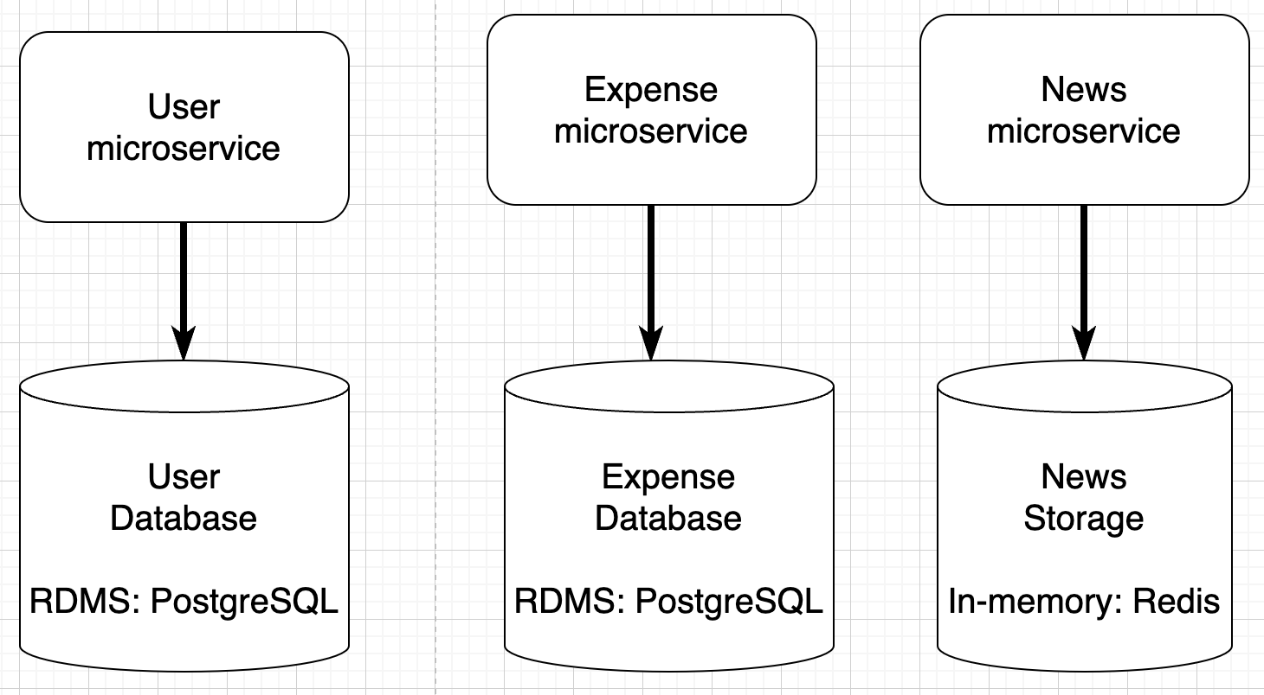
Database per Service
Problem: enable loose coupling between services and enable usage of various storage tools
Solution: database per service pattern
Result:
good:
each service has independent deployability
unique storage system can be used inside each microservice
bad:
no ACID
distributed transactions to be done (by 2PC or SAGAS)

Slide 6
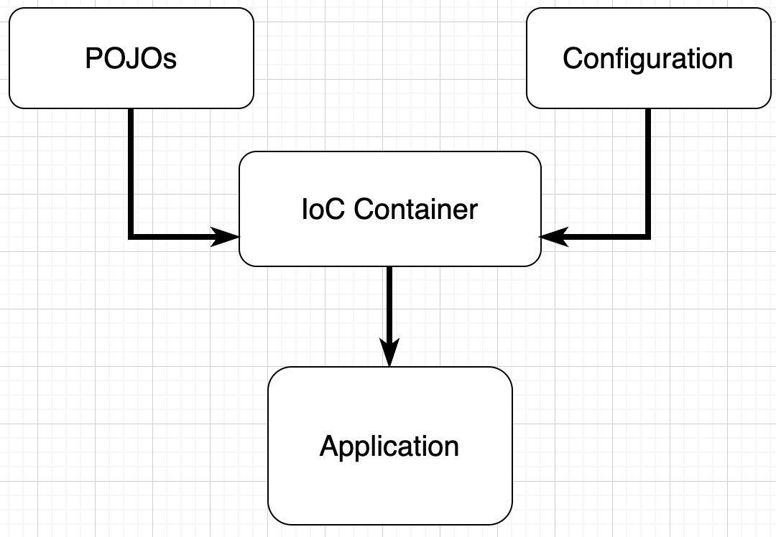
Inversion of control with Dependency Injection
Problem: simplify development of the app using modern framework. IoC is used by most and achieved by many ways. In our case via DI
Solution: use SpringBoot framework where ApplicationContext is an IoC container and DI is done via @Bean
Result:
fast and easy substitution of implementations
program is modular
decoupling between object instantiation and actual implementation
In our case we don’t use XML configuration, but annotations

Slide 7
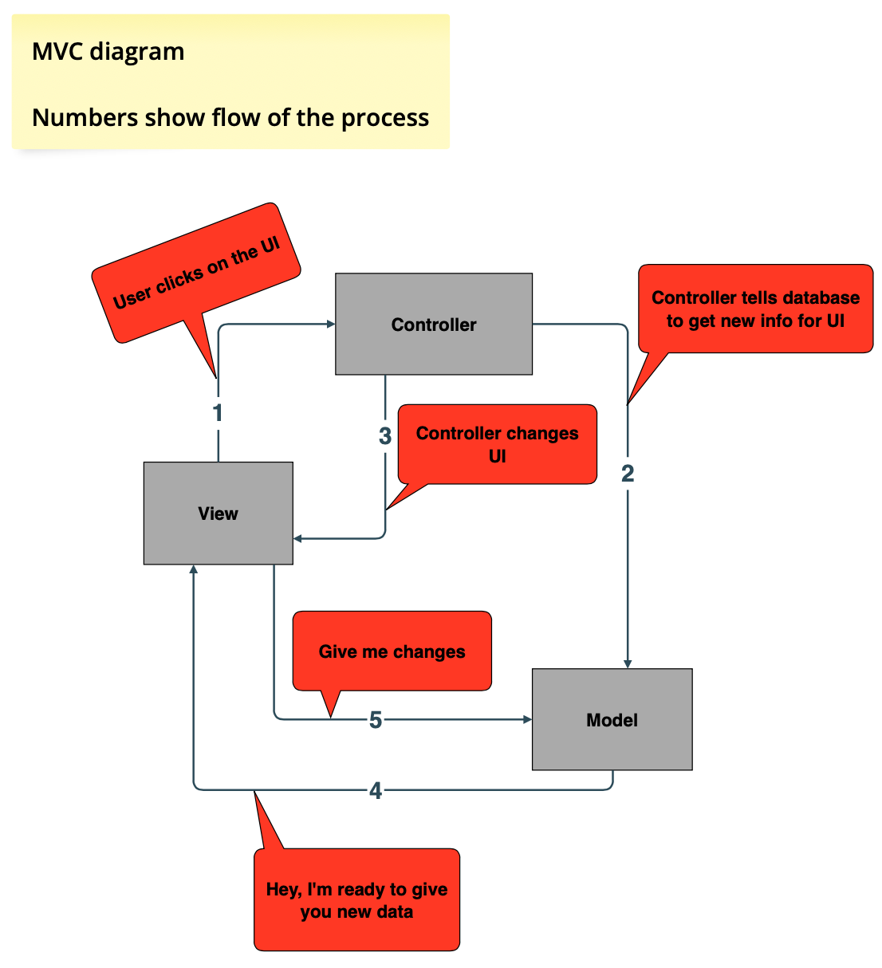
MVC - model view controller
Problem: decouple layers within our microservice (for example, User microservice)
Solution: use MVC where it consists of
Composite pattern (View)
Strategy pattern (View is composed with Controller)
Observer pattern (Model notifies View)
Result: fully decoupled code where we can substitute existing implementations with new ones

Slide 8
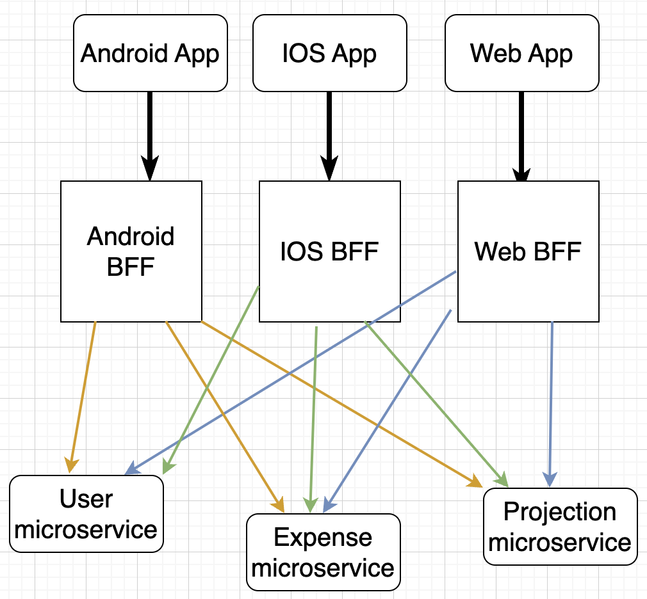
BFF: backend for frontend
Problem: enable support for Android, IOS, Web apps where data on the frontend may vary greatly
Solution: use BFF pattern
Result: no coupling between devices on the frontend part and easy to implement updates when aggregation rules get changed

Slide 9
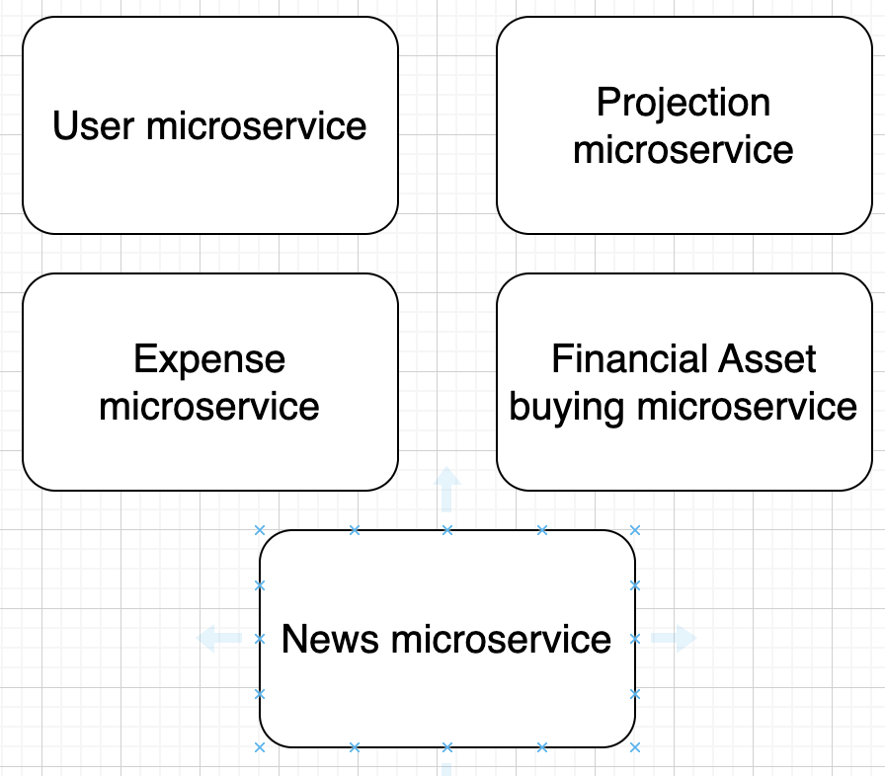
SRP: single responsibility principle
Problem: decompose application into manageable microservices
Solution: decompose by DDD
Subdomains:
User actions (i.e. auth)
Projection
Expense filtering, addition
News aggregation
Financial asset buying
Result: each microservice has Independent Deployability as they’re separated by their concerns, high cohesion inside each service, low coupling between

Slide 10
All resources used
Building Microservices by Sam Newman: https://www.oreilly.com/library/view/building-microservices-2nd/9781492034018/
Design Patterns by O’Reilly: https://www.oreilly.com/library/view/head-first-design/9781492077992/
Chris Richardson website: https://microservices.io/index.html
UML diagrams description: https://www.uml-diagrams.org/interface.html
Baeldung website: https://www.baeldung.com/inversion-control-and-dependency-injection-in-spring
Daniil’s Slobodeniuk Medium: https://medium.com/@SleeplessChallenger
Daniil’s Slobodeniuk Repository with Design Patterns: https://github.com/SleeplessChallenger/KotlinDesignPatterns

